Slide 1


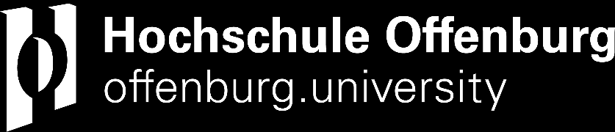
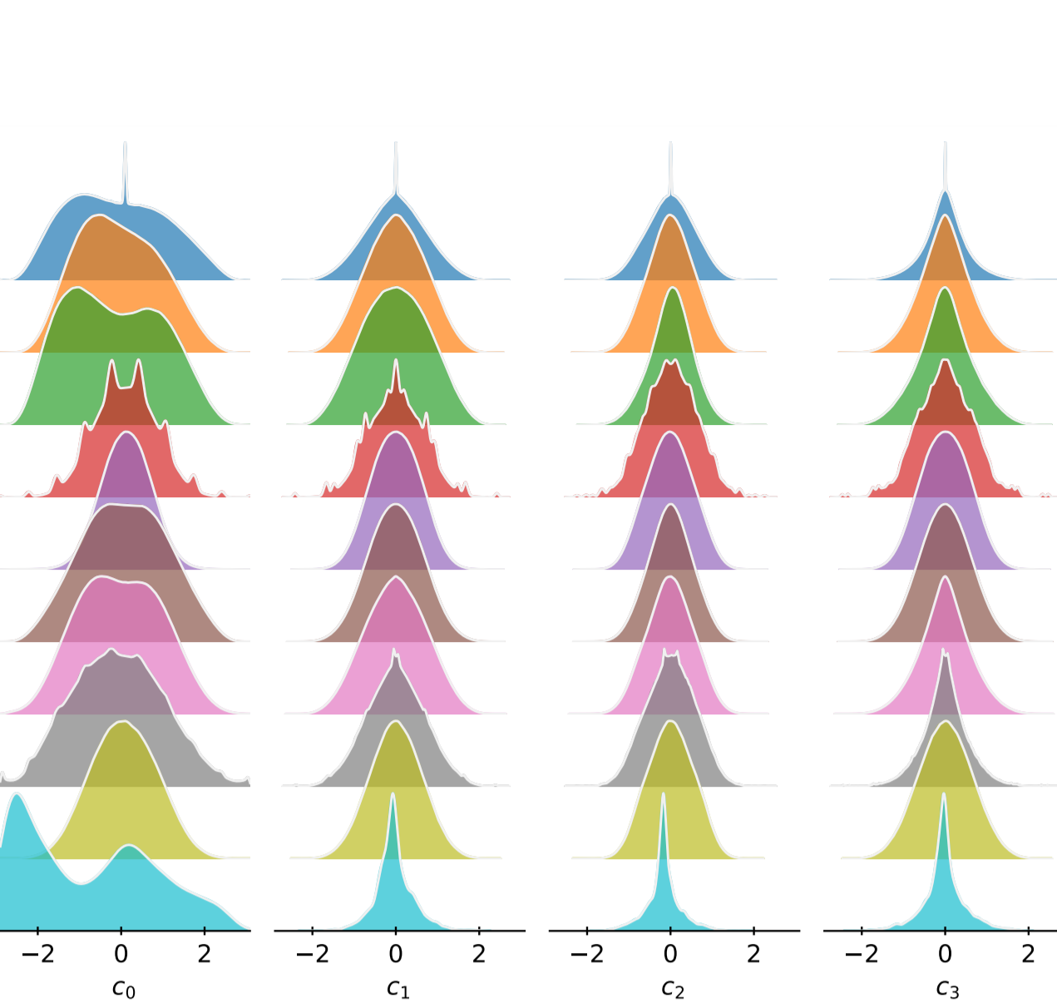
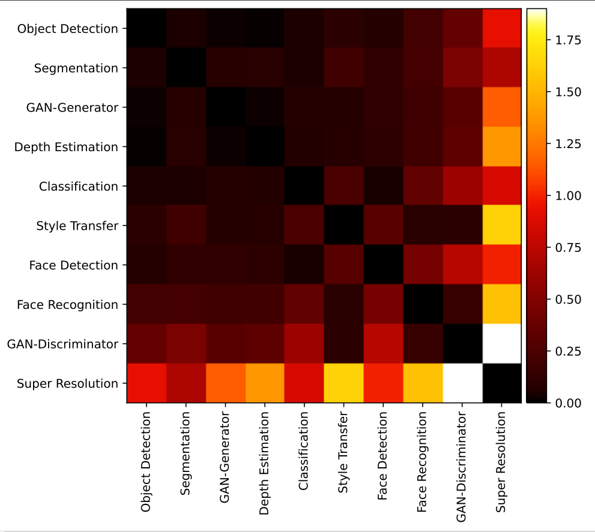

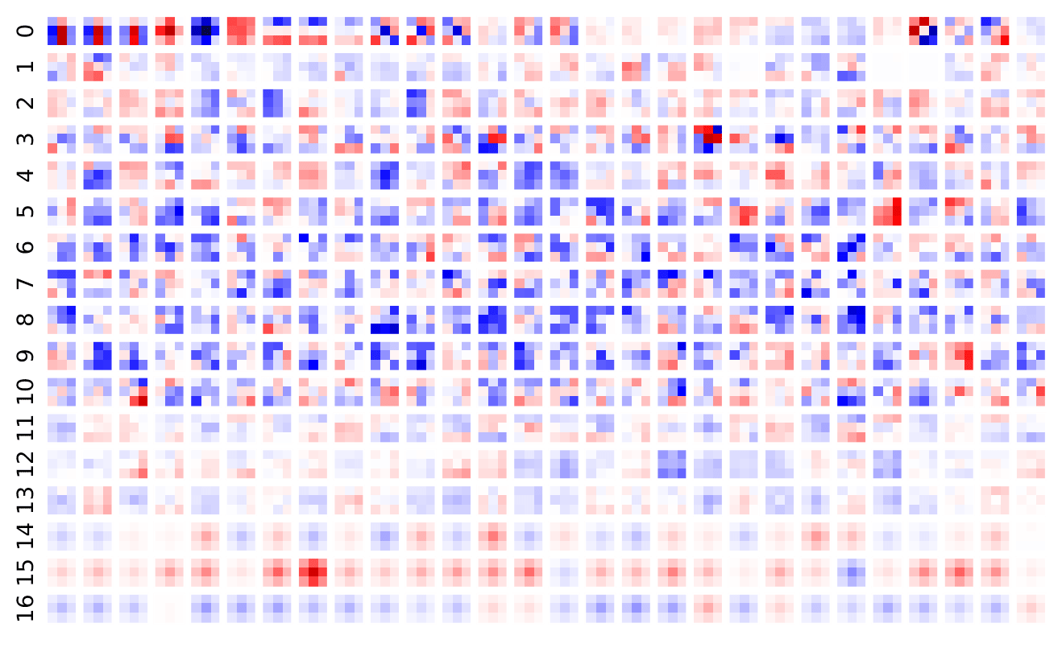
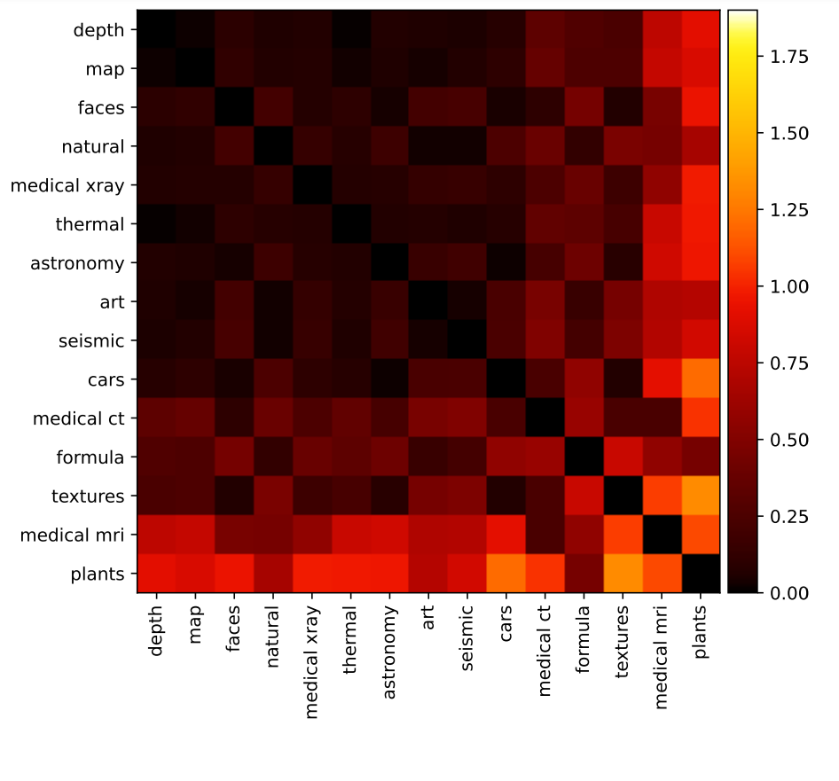
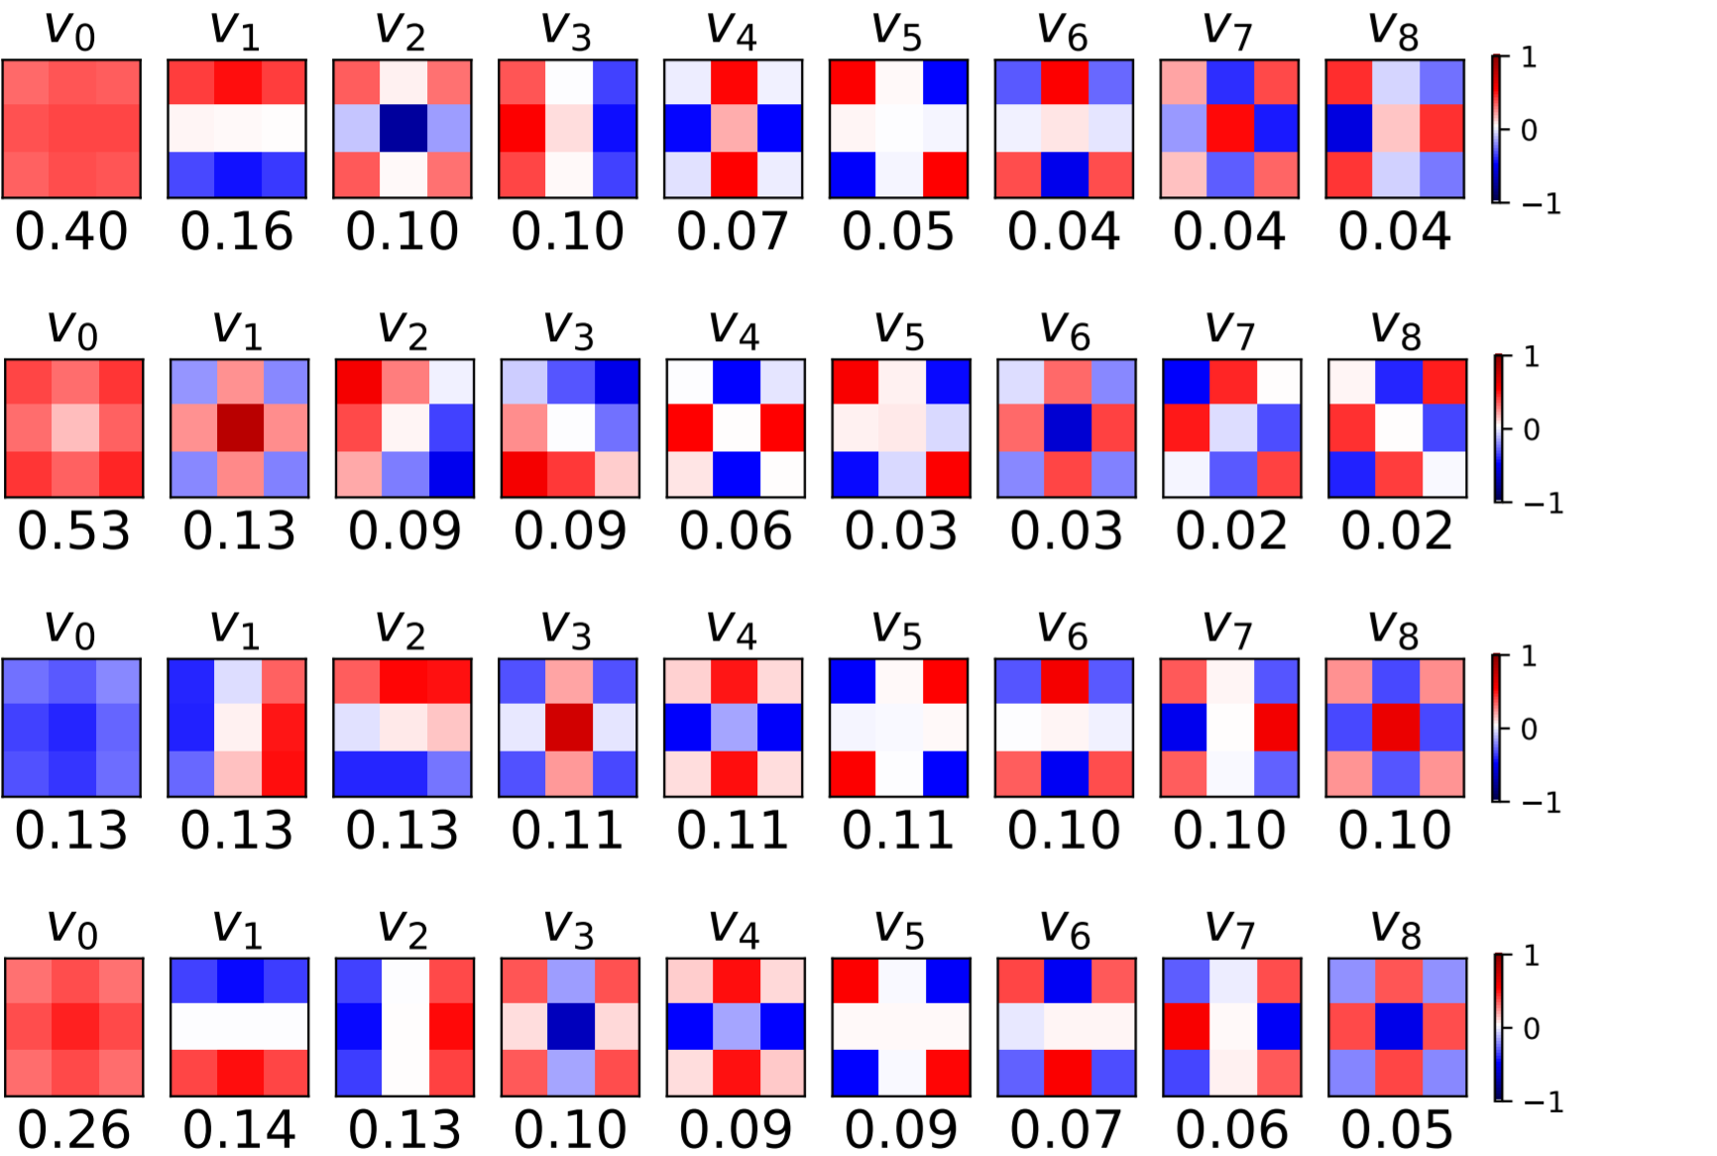
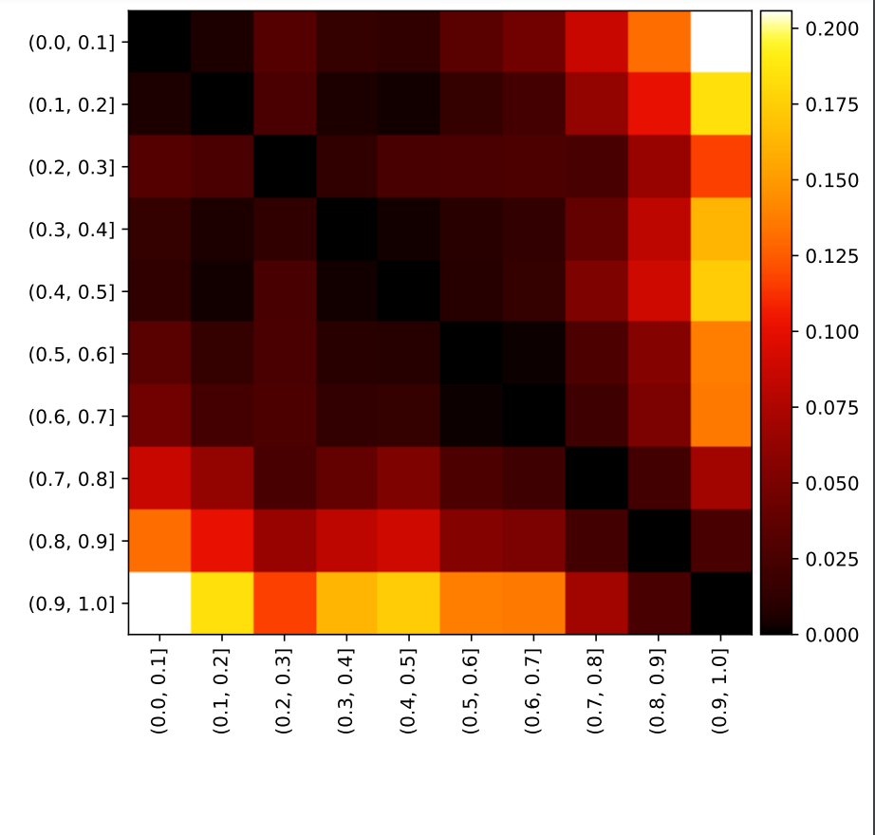
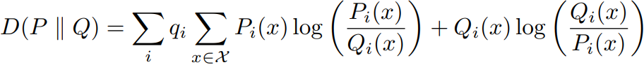
An Empirical Investigation of Model-to-Model Distribution Shifts in Trained Convolutional Filters
Paul Gavrikov, Janis Keuper
Motivation
Distributions shifts
Coefficient distributions
Instead of analyzing the distribution shift in original training and test data, we propose to study shifts in the learned weights of publicly available trained models. In this work, we focus on the properties of the distributions of dominantly used 3x3 convolution filter kernels.
Classification
Depth Estimation
Face Detection
Face Recognition
GAN-Discriminator
GAN-Generator
Object Detection
Segmentation
Style Transfer
Super Resolution
Dataset
Learned Task
391 public CNN models
524,563,289 filters from 13,015 layers
10 tasks: Image Classification, Segmentation, Generation, Super Resolution, …
15 visual categories: natural, x-ray, seismic, depth, …
Visualization of the coefficient distributions along the first 4 principal components for filters grouped by learned task.
Basis functions
All
Visual Category
Category:
formula
Task:
GAN-Discrim.
Visualization of the (degenerated) filters in each layer of a ResNet-18 trained on CIFAR-10.
First Layer
Method
Visualization of the principal components for various subsets with their respective explained variance ratio (below).
We scale each filter per layer-wise peak weight and perform a PCA-transformation of all filters to compare the structure independent of scale. The distribution shift is measured by the sum of symmetric KL-Divergence of the coefficients of each principal component. The sums are weighted by the explained variance of each principal component.
Take-home messages
Layer Depth Decile
(color-scale adjusted)
Public models have a large presence of degenerated filters
The structure of convolutional filters differs across models
On average the distributions are mostly independent of the task of the model and the visual category
Models of the same family show very similar distributions
Filters found across different depth do barely differ, and are slightly different in last decile
Heatmaps showing the shift between filter coefficients grouped by various dimensions. Brighter colors indicate larger shifts.

